Slide 1
How does the sharing economy influence crime rate?
—GROUP 4

Slide 2
MOTIVATION
?
Significance of Sharing Economy:
Large size: tillion USD globally
Economy inclusivity
Resource optimization
Significance of Crime Rate:
Public safety
Economic impact
Health and well-being

Slide 3
MOTIVATION & RESEARCH QUESTION
Scenario 1: higher popularity of sharing economy, lower crime rates.
Increased self-regulation, great!
Scenario 2: higher popularity of sharing economy, higher crime rates.
Increased mobility or ease of access may be problemsome.
Robust identity verification measures, technology for real-time monitoring, etc.
Research question: How does the rising popularity of the sharing economy influence crime rates?

Slide 4
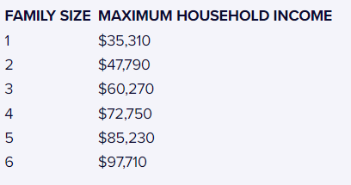
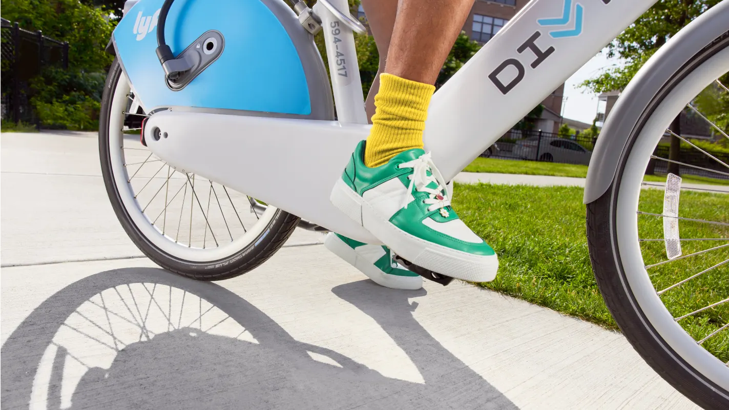
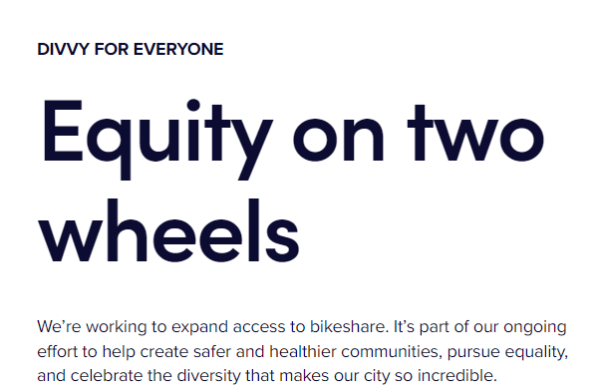
Empirical Setting and Data
Controls:
Demographic Info: Racial & Gender Distribution; Population
Facilities: Police Station; Clinics; Senior Centers; Bike Stations; Affordable Housing Developments
Business Environment: Newly issued business licenses; Violation and Inspections on the businesses; Amount of for Small Business Incentive Awarded
…
Y: Crime Rate
T: Adoption of Bike Sharing
Z: Whether Affected by D4E
$5 v.s. $130.9 /Year
annual household income at or below 300% of the Federal Poverty Level
In 2020, the number of Divvy for Everyone (D4E) members has quadrupled to 8,000 out form 43,000 total members

Slide 5
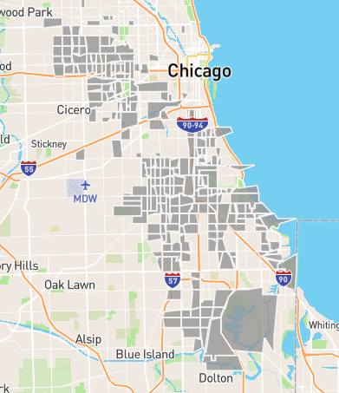

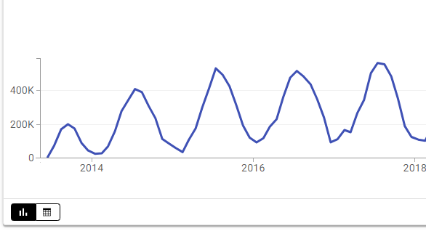
METHODOLOGY
Y: Crime Rate: Crime counts per thousand people
T: Adoption of Bike Sharing：trip counts per thousand people
Z: Whether Affected by D4Es
Unit of analysis: Zipcode x date
Research Period: Jan.2014 - Jan.2017

Slide 6
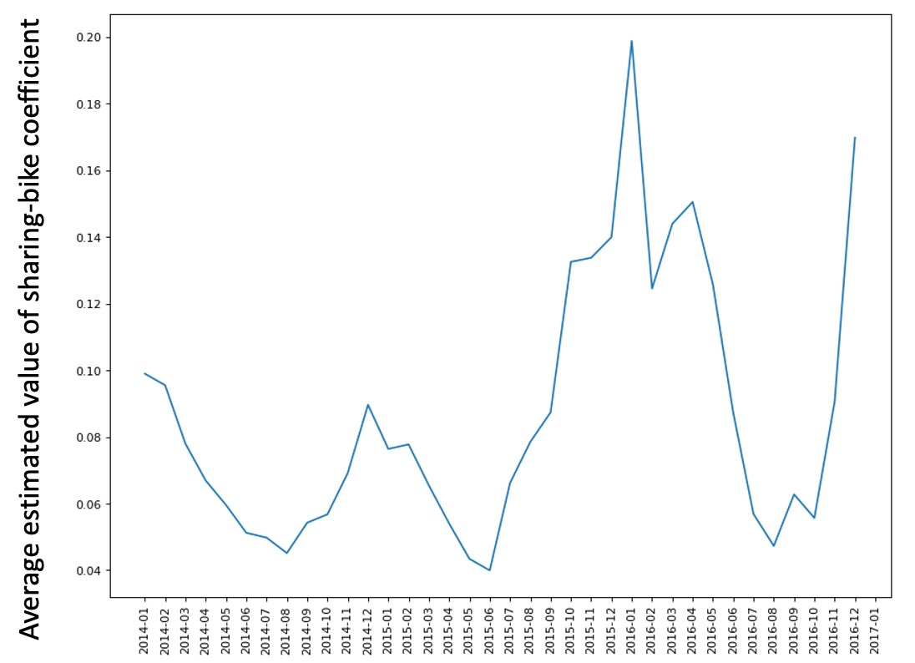
RESULTS: Sharing Bike Increased Crime Rate
In general, higher shared bicycles will induce higher crime rate.

Slide 7
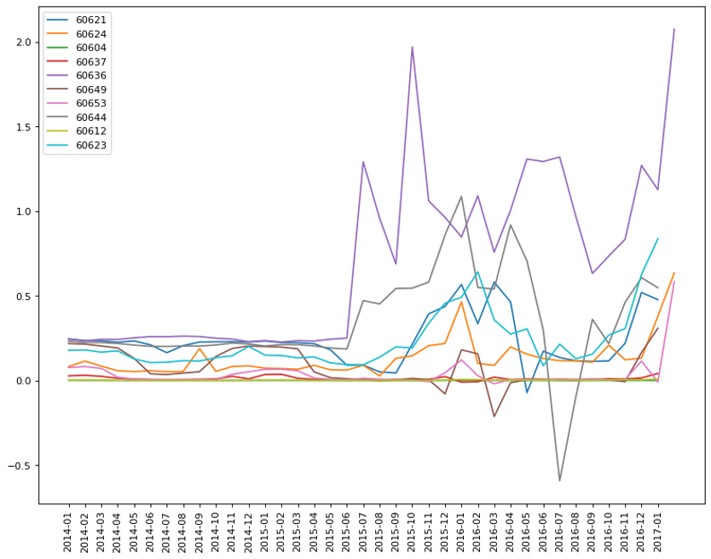
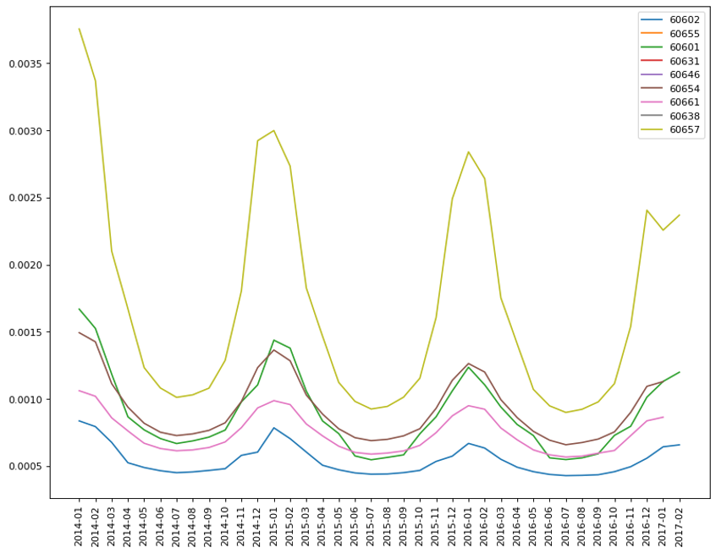
RESULTS: HTE
Top 10 Zipcodes with the Highest Poverty Level
Top 10 Zipcodes with the Lowest Poverty Level
Average estimated value of sharing-bike coefficient

Slide 8
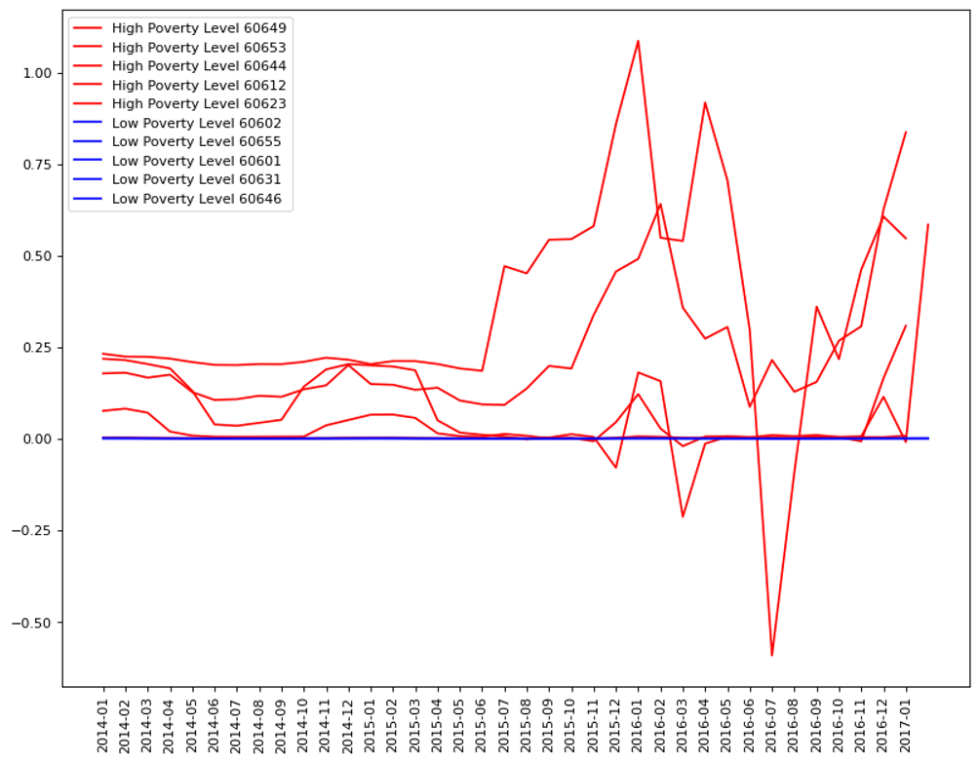
RESULTS: HTE Cont.
The crime rate in high poverty level areas is influenced to a greater and more severe extent by shared bicycles than in low poverty level areas.
Average estimated value of sharing-bike coefficient

Slide 9
CONCLUSION AND NEXT STEP
More popular the sharing economy, higher the crime rate.
More mechanism to be explored.

Slide 10
Thanks!
Any suggestion will be highly appreciated!

